Slide 1
Database Design and Development
Topic 7:
Physical Design (2)
Notes:
NCC Education - Title Master

Slide 2
Scope and Coverage
This topic will cover:
  The concept of derived data
  Designing a representation of derived data
Notes:
NCC Education - Slide Master

Slide 3
Learning Outcomes
By the end of this topic students will be able to:
  Understand the concept of derived data
  Design a representation of derived data
  Recognise the tradeoffs between different ways of implementing derived data

Slide 4
What is Derived Data?
  A column whose value can be found be examining the values of other columns

Slide 5
Table: AcademicClasses
Topic | Room | NoOfStudents
Chemistry | 87 | 30
Mathematics | 99 | 12
English | 32 | 23
Computing | 55 | 30
What is a derived column here?
Where might it be derived from?

Slide 6
Representation of Derived Data
  Not always represented in the data model
  Represented when there is a danger of losing the information
  Derived attributes shown with a ‘/’ in front

Slide 7
Entity: AcademicClass
Topic (PK)
Room
/noOfStudents

Slide 8
AcademicClass
Student
Topic (PK)
Room
/noOfStudents
StudentID (PK)
Name
Address
Count(Student.StudentID)

Slide 9
Adding Pseudo-Code
AcademicClass
Student
Topic (PK)
Room
/noOfStudents
StudentID (PK)
Name
Address
Topic(FK)
Count(Student.StudentID) AcademicClass.Topic =
Student.Topic
Why do we Count the StudentIDs ?

Slide 10
What Sort of Documents/ Applications will use Derived Fields? - 1
  Activity: Brainstorm – write down as many documents or applications that might use derived fields in a business.

Slide 11
What Sort of Documents/ Applications will use Derived Fields? - 2
  Activity: Brainstorm – write down as many documents or applications that might use derived fields in a business.
Invoices
Receipts
Order Forms

Slide 12
Using Derived Data to think about a Data Model
  Remember data modelling is about semantics, the meaning of the data.

Slide 13
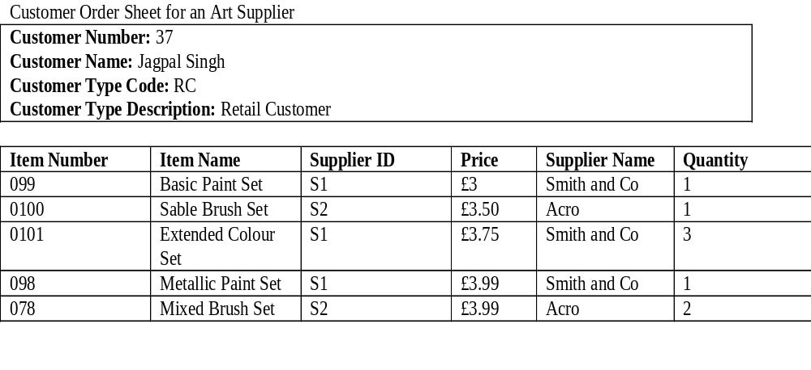
Original Customer Order Sheet for Art Supply Shop

Slide 14
Adding a Total for Each Item and the Order Itself
Order ID: 4343
Item Total
£3.00
£3.50
£11.25
£3.99
£7.98
Total: 29.72

Slide 15
The Entity Relationship Diagram
Customer
1
0...*
CustomerItem
0...*
1
Item
0...*
1
Supplier

Slide 16
The Modified Entity Relationship Diagram
Customer
1
0...*
Order
1
0...*
OrderItem
0...*
1
Item
0...*
1
Supplier

Slide 17
The Modified Entity Relationship Diagram – Deriving Totals for Each Item
Customer
1
0...*
Order
1
0...*
OrderItem
0...*
1
Item
0...*
OrderItem
OrderID (PK) (FK)
ItemID (PK) (FK)
Amount
/ItemTotal (Amount * Item.Price Where OrderItem.ItemID = Item.ItemID
1
Supplier

Slide 18
The Modified Entity Relationship Diagram – Deriving Total for Order
Customer
1
0...*
Order
1
0...*
OrderItem
0...*
1
Item
0...*
Order
OrderID (PK)
CustomerID(FK)
Date
/Total (Sum(OrderItem.ItemTotal) Where OrderItem.OrderID = Order.OrderID
1
Supplier

Slide 19
How it Works Physically - 1
Customers
Step 1. Customer makes an order
Create new row in Orders table
1
0...*
Orders
1
0...*
OrderItems
0...*
1
Items
0...*
1
Suppliers

Slide 20
How it Works Physically - 2
Customers
Step 2. A number of rows are created in
The OrderItems table
1
0...*
Orders
1
0...*
OrderItems
0...*
1
Items
0...*
Step 3. For each OrderItem the
Total is calculated.
1
Suppliers

Slide 21
How it Works Physically - 3
Customers
1
0...*
Orders
1
0...*
OrderItems
0...*
1
Items
0...*
Step 4. For the Order the Total is
calculated
1
Suppliers

Slide 22
Overheads of Derived Data
  Additional storage of extra attribute
  New calculation every time a value in the source field is changed
  Possibility of data becoming inconsistant

Slide 23
Calculating at Run Time
  The Order Form and similar documents such as invoices and receipts would be created as applications
  The totals calculated as they are needed
  Totals not stored in database: no derived fields

Slide 24
Paper Based Report
Step 1. Report or Form
run.
Screen based Form or Report

Slide 25
Paper Based Report
Step 2. Data used to
calculate data that is derived
from other data.
Screen based Form or Report

Slide 26
Paper Based Report
Step 3. Data and
derived field sent to
application
Screen based Form or Report

Slide 27
Aggregate Functions that can be used to Derive Data
  Count – returns number of values in a column
  Sum – returns the sum total of values of a column
  Avg – returns the mean average of values in column
  Min – returns the lowest value in a column
  Max – returns the highest value in a column

Slide 28
Standard SQL for Derived Column in Create Table Statement
  CREATE TABLE ProductsStock
  (
  ...
  Product_itemID INTEGER NOT NULL,
  list_price DECIMAL(7,2) NOT NULL,
  Quantity INTEGER NOT NULL,
  stock_value GENERATED ALWAYS AS (Quanity * list_price),
  ...
  )

Slide 29
Example of Insert Statement with Derived Data
  INSERT INTO employee_year_earnings
  SELECT employee_id, salary*12
  FROM employees;

Slide 30
Derived Attribute or Calculation at Run Time?
  How complicated is the calculation to be made?
  Does it involve multiple table joins and so could impact performance?
  How often would a derived attribute be updated? Could this affect performance.

Slide 31
Other Types of Derived Fields – Non Numeric
  Potentially any type of business rule could be used to derive data
  e.g. Items of a particular sort will all be the same colour
  Would need to used more complex embedded procedural logic such as a database trigger or macro

Slide 32
Learning Outcomes
By the end of this unit students will be able to:
  Understand the concept of derived data
  Design a representation of derived data
  Recognise the tradeoffs between different ways of implementing derived data
Did we meet them?

Slide 33
References - 1
  Connolly, Thomas M., and Begg, Carolyn E., Database Systems: A Practical Approach to Design and Implementation Addision-Wesley, Fourth Edition 2005 Chapter 17
  Connolly, Thomas and Begg, Carolyn Database Solutions: A step-by-step guide to building database Addison-Wesley 2nd Edition 2004 Chapter 12

Slide 34
References - 2
  The Derivation in the Data Model at http://wiki.webratio.com/index.php/The_derivation_in_the_data_model Retrieved 7th June 2011
  SQL derived data http://forums.mysql.com/read.php?10,361286,361286 Retrieved 20th July 2011

Slide 35
Topic 7 – Physical Design (2)
Any Questions?
Notes:
NCC Education - End Slide Master

